Slide 1
Chapter -4
TRIBAL COMMUNITIES

Slide 2
DIFFERENT TRIBAL GROUPS
MUNDAS
SANTHALS CHOTANAGPUR REGION
ORAONS
BAIGAS
GONDS CENTRAL INDIA
KHONDS
KHASIS
NAGAS NORTH EAST
9/7/2020

Slide 3
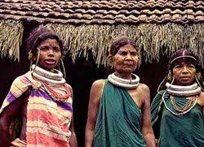
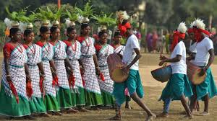
TRIBALS
MUNDAS
SANTHALS
9/7/2020

Slide 4
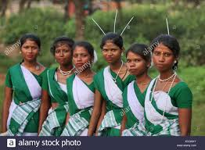
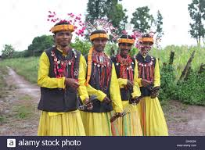
TRIBALS
ORAONS
BAIGAS
9/7/2020

Slide 5
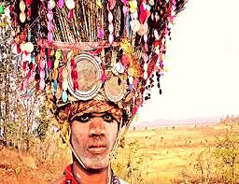
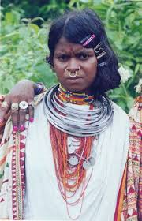
TRIBALS
GONDS
KHONDS
9/7/2020

Slide 6
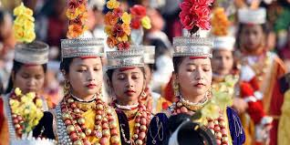
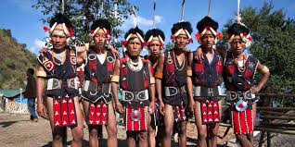
TRIBALS
KHASIS
NAGAS
9/7/2020

Slide 7
SOCIETY
DID NOT FOLLOW CASTE RULES
MORE EQUALITY AMONG THEM
WHOLE TRIBE OWNED THE LAND
DISTINCT CUTURE – DID NOT WANT ANYONE TO INTERFERE.
EACH TRIBAL GROUP HAD DISTINCT CUSTOMS , RITUALS BELIEFS
9/7/2020

Slide 8
SHIFTING CULTIVATION
SHIFTING CULTIVATION IS ALSO
CALLED AS
JHOOM CULTIVATION
OR
SLASH AND BURN CULTIVATION
9/7/2020

Slide 9
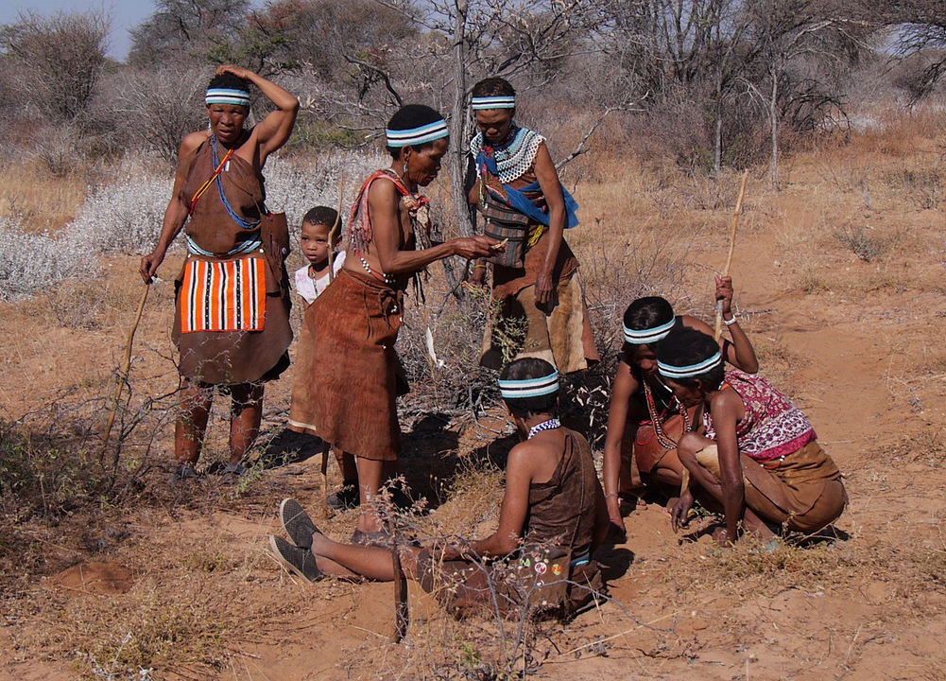
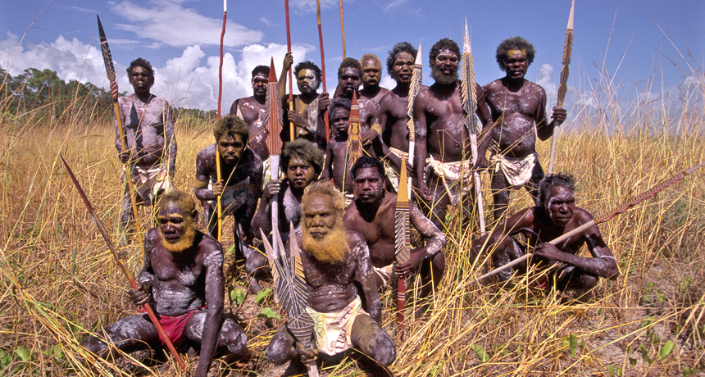
HUNTING AND GATHERING
THEY COLLECTED:
FRUITS, ROOTS, HONEY, MEDICINAL HERBS.
BARTER SYSTEM EXISTED.
THEY WERE CALLED
PEOPLE OF FOREST
9/7/2020

Slide 10
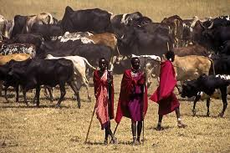
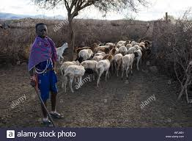
HERDING AND REARING
MOST OF THE TRIBALS WERE NOMADS
THEY WERE DEPENDENT ON HERDS OF SHEEP AND CATTLE.
WHEN THE SUPPLY OF FOOD FOR THESE ANIMALS GOT EXHAUSTED IN AN AREA, THEY MOVED TO ANOTHER AREA.
9/7/2020

Slide 11
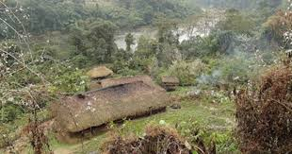
SETTLED AGRICULTURE
MUNDAS AND SANTHALS
TOOK TO SETTLED
AGRICULTURE.
9/7/2020

Slide 12
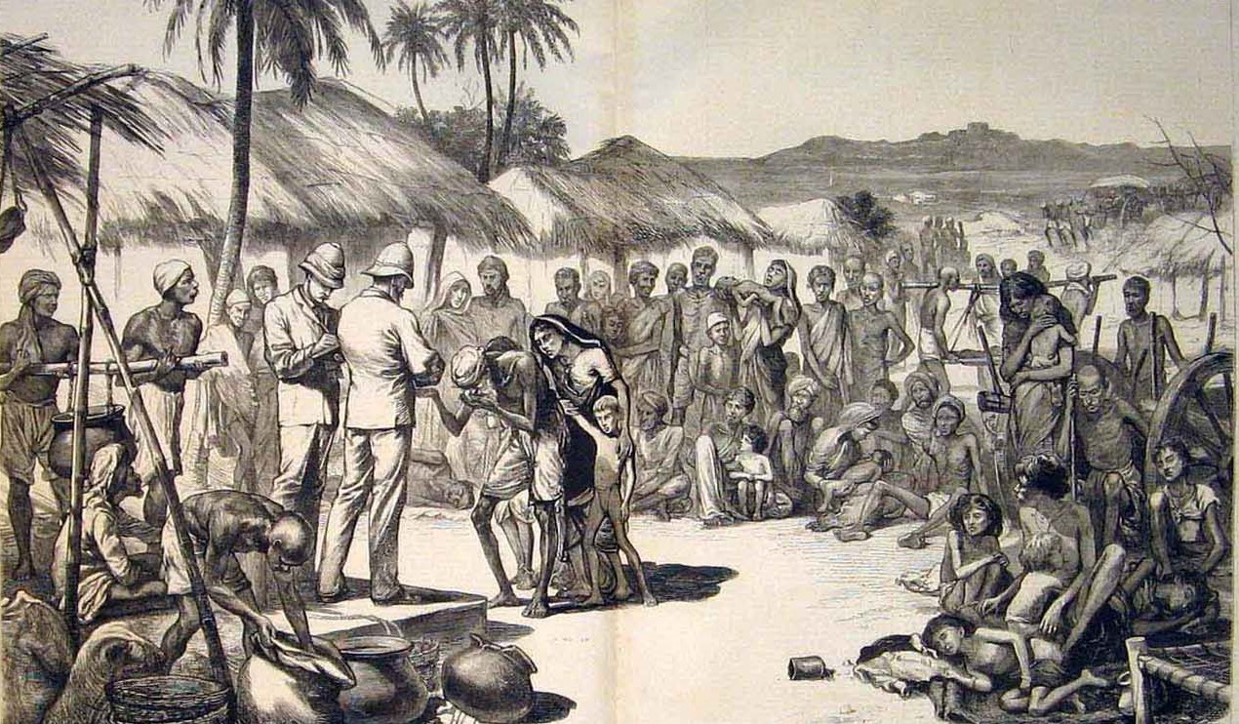
British rule affects the tribals
Tribals dispossessed their land
High revenue demand
Settled agriculture
Changes in forest laws
9/7/2020

Slide 13
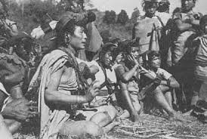
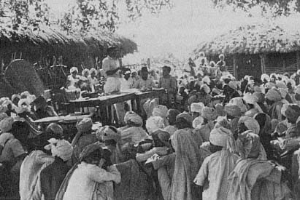
ROLE OF TRADERS AND MONEY LENDERS
TRADERS
MONEY LENDERS
9/7/2020

Slide 14
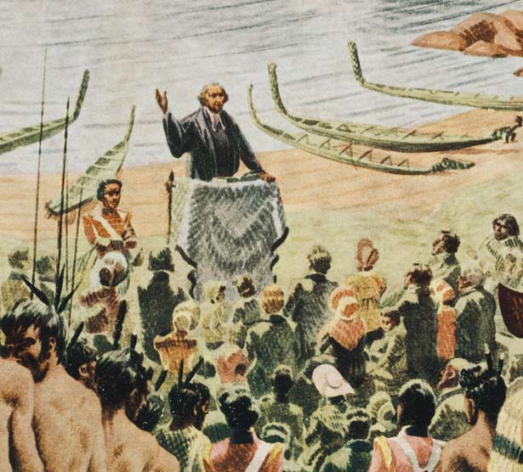
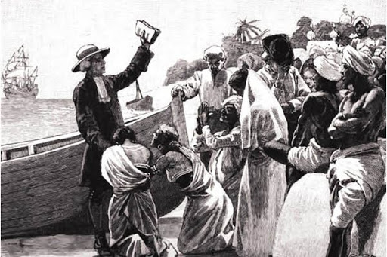
ROLE OF CHRISTIAN MISSIONARIES
The Interference of christian misionaries added a threat to the life of tribals.
TRIBAL CHIEF
LOST THEIR FORMER IMPORTANCE
LOST THEIR POWER
LOST THEIR AUTHORITY
THIS INFURIATEED THE TRIBALS
9/7/2020

Slide 15
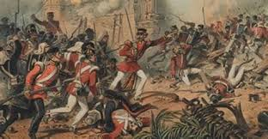
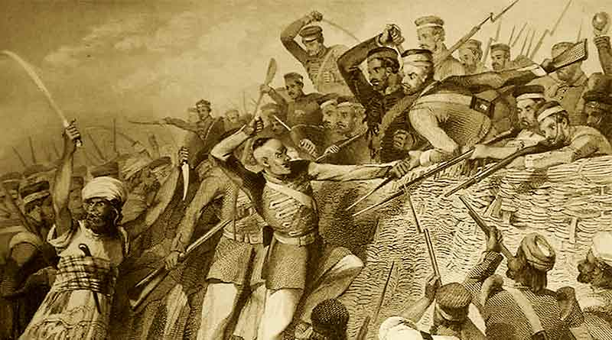
TRIBAL REVOLT
KOL REBELLION
SANTHAL REBELLION
1855
1831-32
9/7/2020

Slide 16
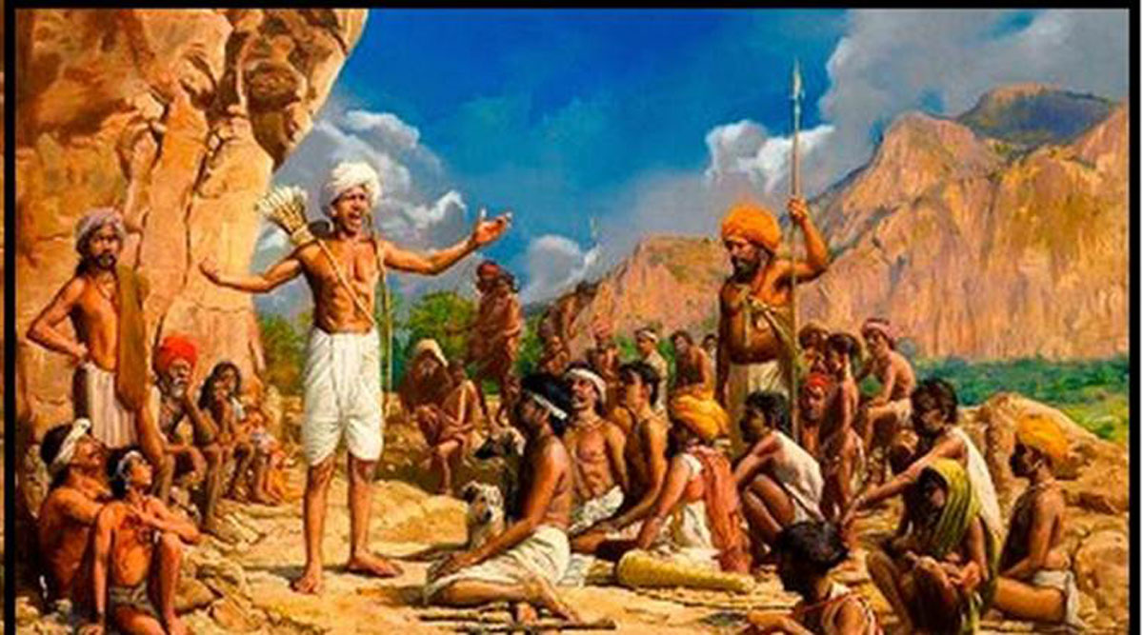
MUNDA REBELLION
Most powerful tribal revolt.
Called as ulgulan or Great Tumult
Led by Birsa Munda
Wanted to establish MUNDA RAJ.
Wanted to bring back the golden age.
Gave up evil practices like: drinking liquor, performing animal sacrifices, worship of evil spirit. Dishonest life.
Against christian missionaries.
Birsa was arrested in 1895.
He died soon after .
9/7/2020

Slide 17
QUESTIONS RELATED TO ABOVE SLIDES.
1)Discuss the role of tribal chiefs under the British.
2) What were the grievances of the tribals against the British?

Slide 18
REFERENCES & THANKING SLIDE
https://www.youtube.com/watch?v=Vw4vdEStr5E
rsgr.in/sh0152

